Slide 1
How to present your Data Science project with Streamlit ?

Slide 2
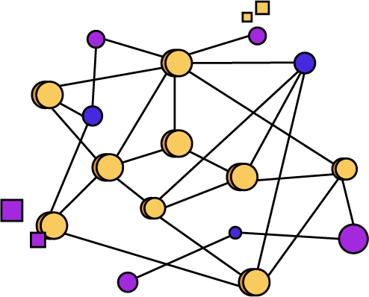
What is Streamlit ?

Slide 3
Streamlit definition
Streamlit is a Python library created in 2018
It allows to create interactive web applications with many widgets
It is therefore a very useful tool for presenting the results of a Data Science project (DataVizualization figures, predictions by Machine Learning models)

Slide 4
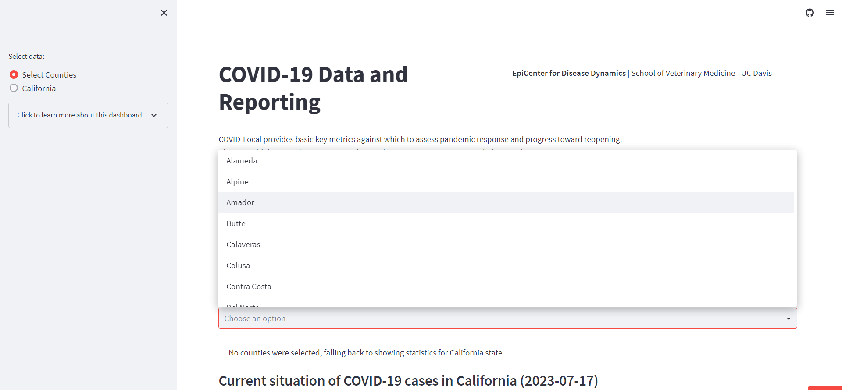
https://streamlit.io/gallery
https://studio.datascientest.com/project/betpy/

Slide 5
Streamlit VS PowerBI
PowerBI : Business Intelligence tool, allows to make rapid decisions thanks to DataVizualization, dashboards and interactive reports, really useful for companies
PowerBI has its own programming language and graphical interface
Streamlit: tool for presenting entire Data Science projects (not just DataVizualization) in a visual and summarized way, really useful to communicate results to other teams
Streamlit is a Python library

Slide 6
Key points of Streamlit

Slide 7


To create a Streamlit web application, use a code editor, not a notebook
Main code editors :
Spyder or VisualStudioCode to obtain a Python file in .py format

Slide 8
2. Then use the commands in a Terminal (Anaconda Prompt Terminal for Windows, classic Terminal for macOS/Linux)
Main commands :
pip install streamlit : installs the streamlit library
cd : places the program in the correct folder on the computer (the folder containing the .py file)
streamlit run : launches the Streamlit web application
Tips for macOS/Linux : check that pip is well installed and can be used as a command

Slide 9
Let’s create a Streamlit web application !

Slide 10
The project that we want to present with Streamlit :
We place ourselves in the context of a property project. The aim is to predict the price of a property based on its characteristics
To do so, we have access to a "housing.csv" file containing properties data
Before presenting the project, we have to work on it as usual in a notebook. We follow the classic steps of a Data Science project to do our predictions using Machine Learning

Slide 11
Now that we finished working on the project, we can present it to our team or to other teams by using Streamlit
Step 1 : Install Streamlit using the Terminal command
Step 2 : Creation of a streamlit_immobilier.py file on Spyder
Step 3 : Adapt our code from the notebook to the file to streamlit_immobilier.py, by including Streamlit commands
Step 4 : Use Terminal commands to launch the Streamlit web application
Streamlit documentation : https://docs.streamlit.io/library/api-reference

Slide 12
Key points to escape errors in Streamlit

Slide 13
Key points to escape errors in Streamlit :
install Streamlit in the correct place (especially correct Python environment)
-> pip freeze on your Python environment
check that all the files are in the same folder : Streamlit .py file, csv files for the dataframes, joblib files for the saved models
pay attention to the use of VSCode (VSCode from Anaconda or not ? Terminal running the Streamlit .py file in the correct root directory ?)
pay attention to the packages dependencies and versions
-> Matplotlib : install Streamlit may unlink Matplotlib to any GUI backends depending on its version (pip install pyqt5)
-> Matplotlib : requirements.txt file on the main branch of the GitHub repository

Slide 14
How to share your Streamlit web application ?

Slide 15
Streamlit sharing :
1st option : continue to work locally by sending the .py file to someone who knows Anaconda and Terminal commands
2nd option : host the application on the Streamlit Cloud (https://streamlit.io/cloud)

Slide 16
Streamlit Cloud Hosting :
Streamlit Cloud : allows to easily share a Streamlit web application (especially with people who do not know how to use the Terminal of commands)
Streamlit Cloud Hosting is made using a GitHub repository :
create a GitHub repository for the whole project
upload the .py file containing the Streamlit code on the repository
create an account on the Streamlit cloud
associate the GitHub repository to the Streamlit account
deploy the application on the Streamlit Cloud

Slide 17
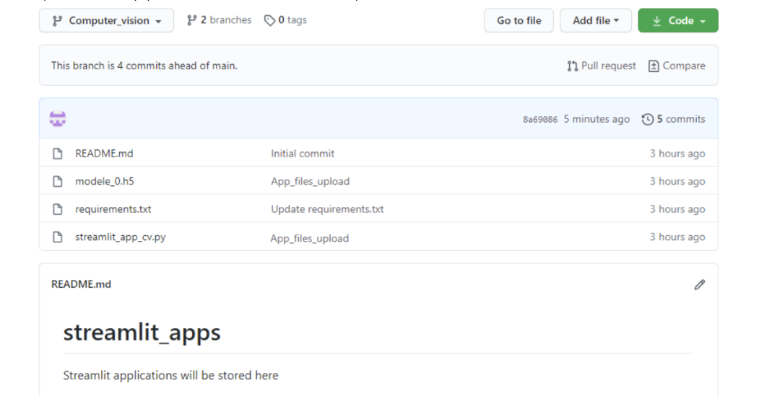
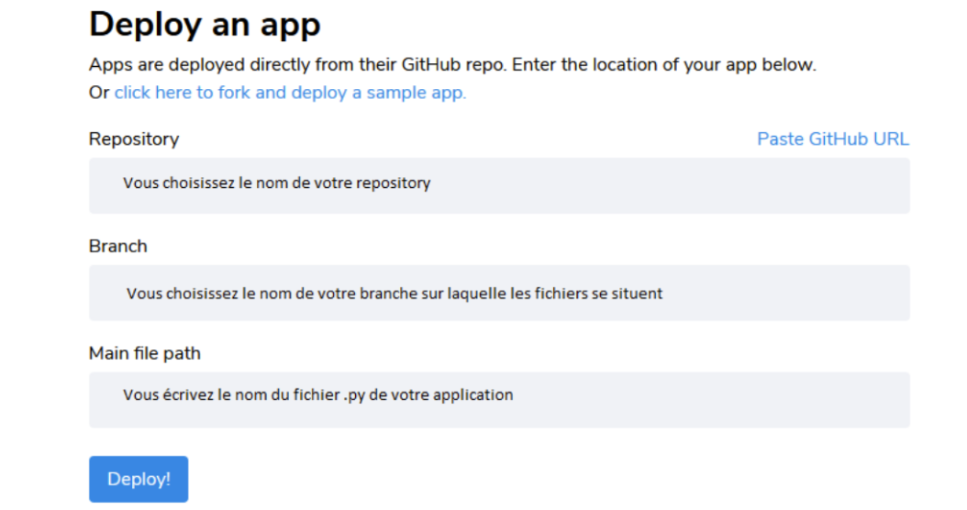

Slide 18
Hosting privacy :
Unlimited number of Streamlits hosted from public GitHub repositories
Limited number of Streamlits hosted from private GitHub repositories (allow a private hosting on the Streamlit Cloud)
Confidential Data Management with "Streamlit Secrets" : sensitive parts of data/code are stored in a file without being committed to the GitHub repo. They can then be accessed on Streamlit as environment variables using the "Advanced settings" tab when deploying to the Streamlit cloud and using the st.secrets() function in the .py file

